Slide 1
High Pressure Detection Project(1)
Name : Thomas Ashraf Zaki
Profile : Click Here
GitHub : Click Here

Slide 2
Project Is
Customer Want pressure controller That Turn On Alarm if The value of pressure Above 20 BAR
By Make All this files using System architecting → (UML2)
Without use any IDE to write the files
Make the linker script , startup and makefile

Slide 3
Using Design Sequence
Space exploration
System Analysis
System Design
Case Study
Method
Requirement

Slide 4
Case Study
A ”client” expects you to deliver the software of the following system:
Specification (from the client)
A pressure controller informs the crew of a cabin with an alarm when the pressure exceeds 20 bars in the cabin
The alarm duration equals 60 seconds.
Assumptions
The controller set up and shutdown procedures are not modeled
The controller maintenance is not modeled
The pressure sensor never fails
The alarm never fails
The controller never faces power cut

Slide 5
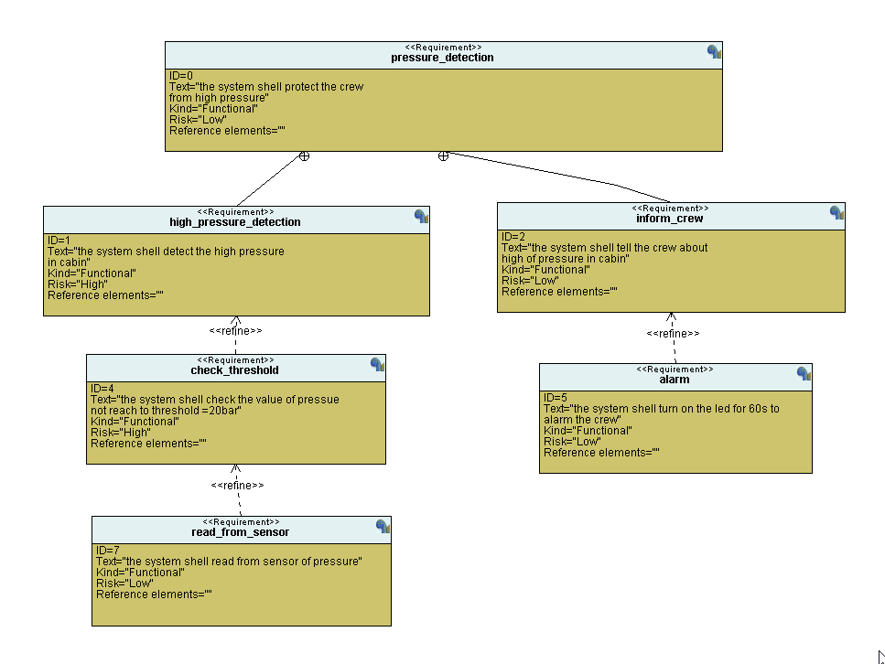
Requirement

Slide 6
System Analysis
Analysis method
System boundary and main functions →Use Case Diagram
Relations between main functions →Activity Diagram
Communications between main system entities and actors →Sequence Diagram

Slide 7
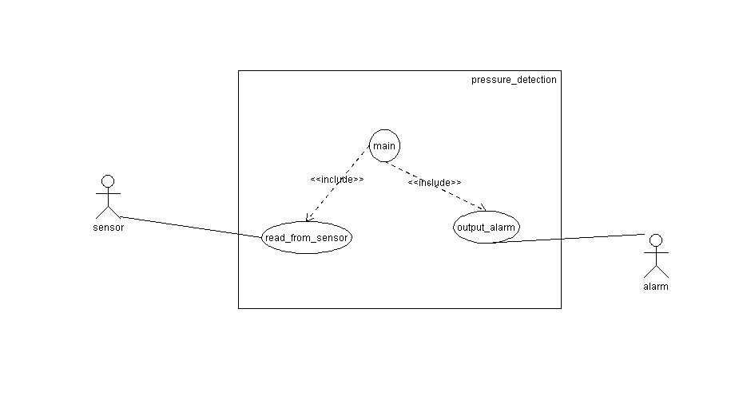
1-Use Case Diagram
Shows what the system does and who uses it
1.Define the boundary of the system
Inside of the rectangle →What you promise to design
Outside of the rectangle →System environment (= Actors)
This is not part of what you will have to design
Name the system
1.Identify the services to be offered by the system
Only services interacting with actors
2.Draw interactions between functions and actors

Slide 8
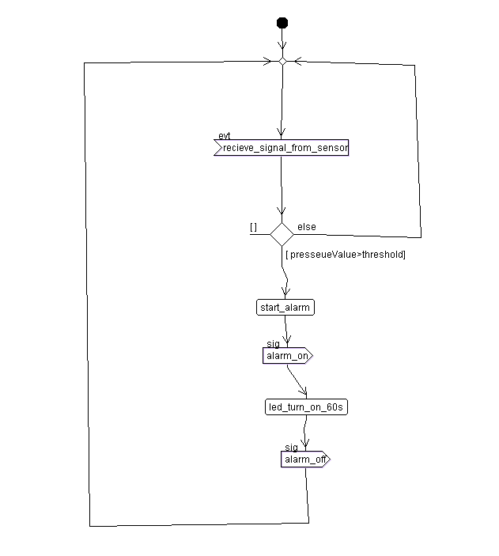
2-Activity Diagram
Activity diagrams describe the workflow behaviour of a system
An activity diagram is a special case of a state chart diagram in which states are activities (“functions”)

Slide 9
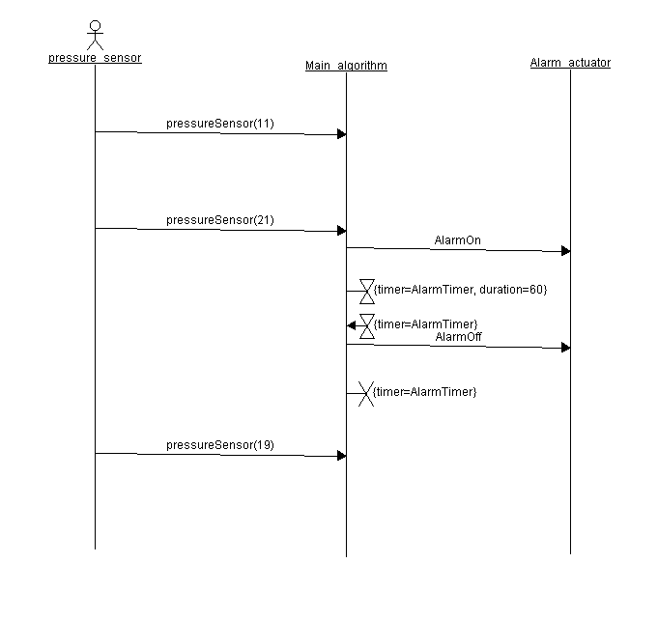
3-Sequence Diagram
An interaction diagram that details how operations are carried out.
What messages are sent and when.
Sequence diagrams are organized according to time
NO message between actors
One global clock (applies to the entire system)

Slide 10
System Design
Design = Making what a client wants
”creating a system” that complies with the client requirements.
System architecture →Block Definition Diagram and Internal Block Diagram
Behaviour of the system →State Machine Diagram
One state machine diagram per block

Slide 11
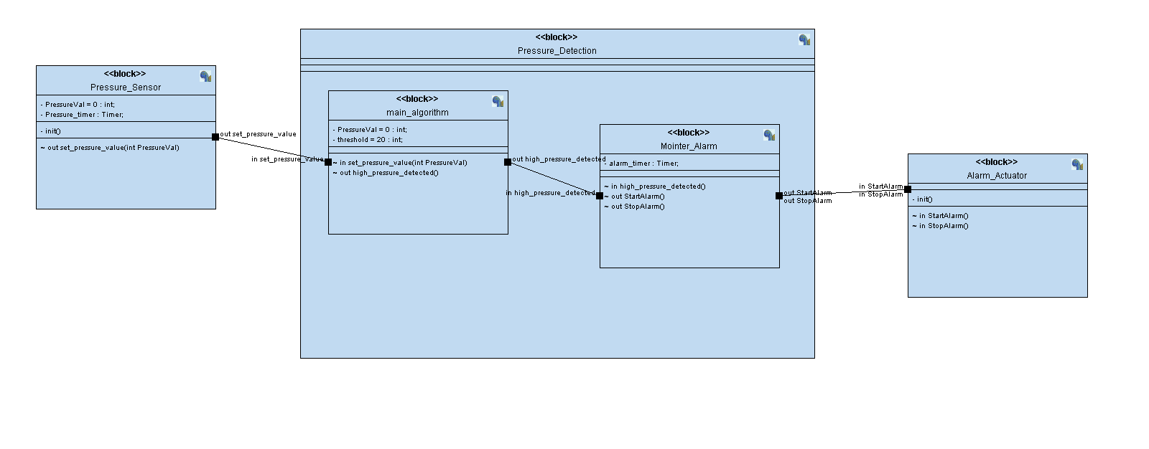
Block Definition Diagram and Internal Block Diagram

Slide 12
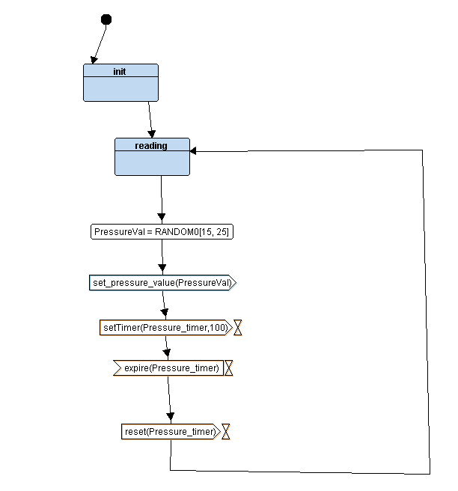
State Machine Diagram of Pressure Sensor
Content : 2 states ,1 timer
Take the value and send it to main algorithm block
timer to take time until finished the process

Slide 13
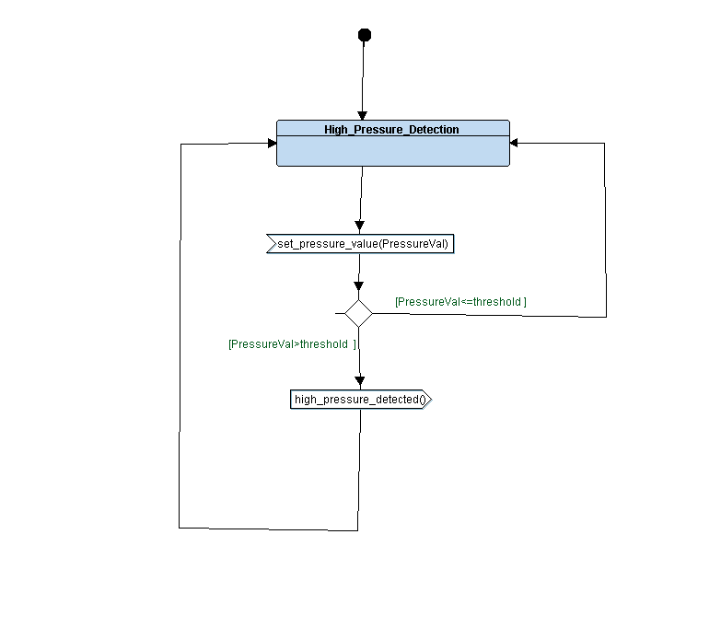
State Machine Diagram of Main Algorithm
Content : 1 states
Receive the value
if pressure>threshold ,send message to Monitor
Else return to the same state

Slide 14
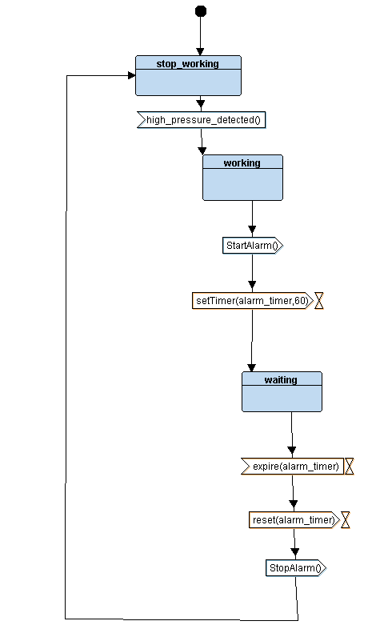
State Machine Diagram of Alarm Monitor
Content : 3 states ,1 timer
Take the Message of high pressure from Main Algorithm Block
Working state send message to turn on alarm to actuator
timer to 60s and send message to turn off alarm to actuator

Slide 15
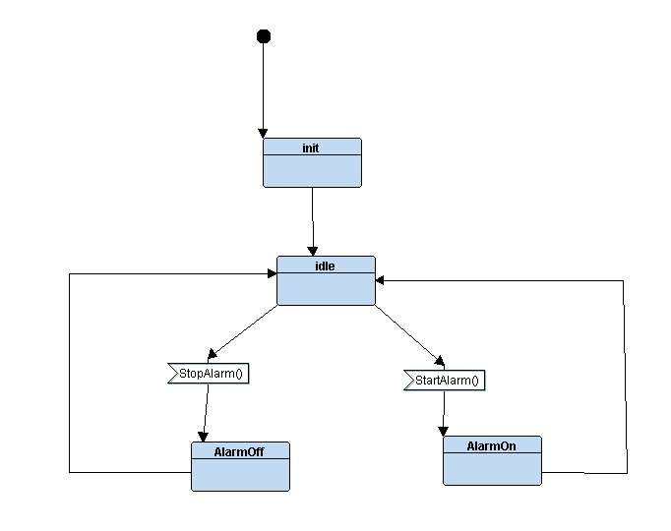
State Machine Diagram of Alarm Actuator
Content :4 states
Take the message from monitor TO
Start or Stop alarm

Slide 16
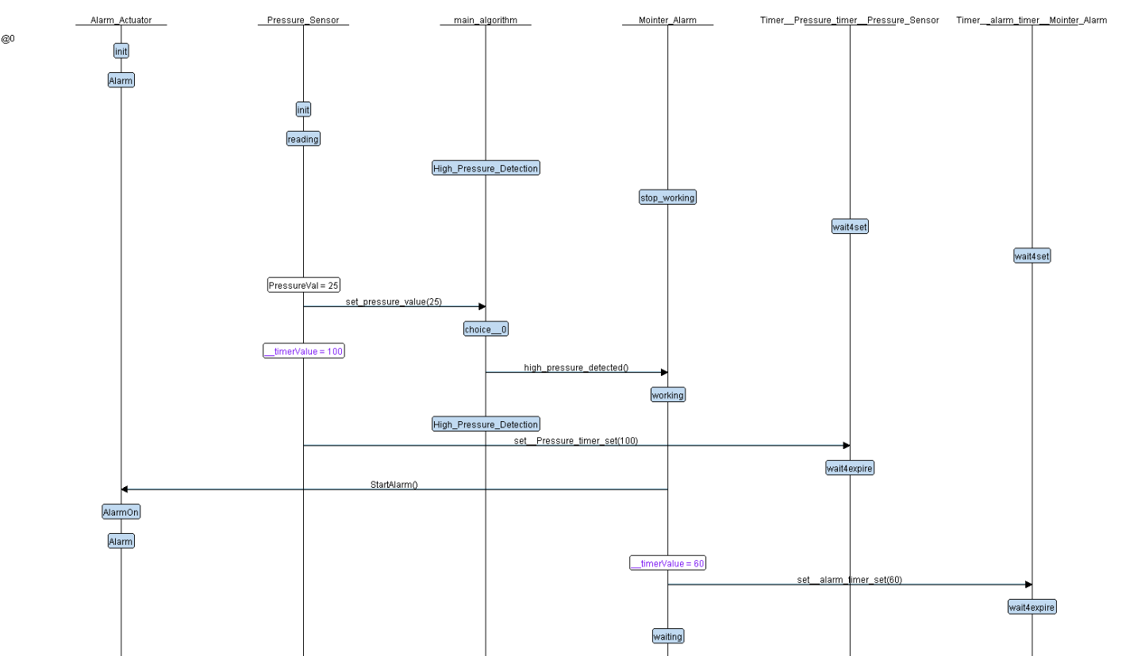

Slide 17
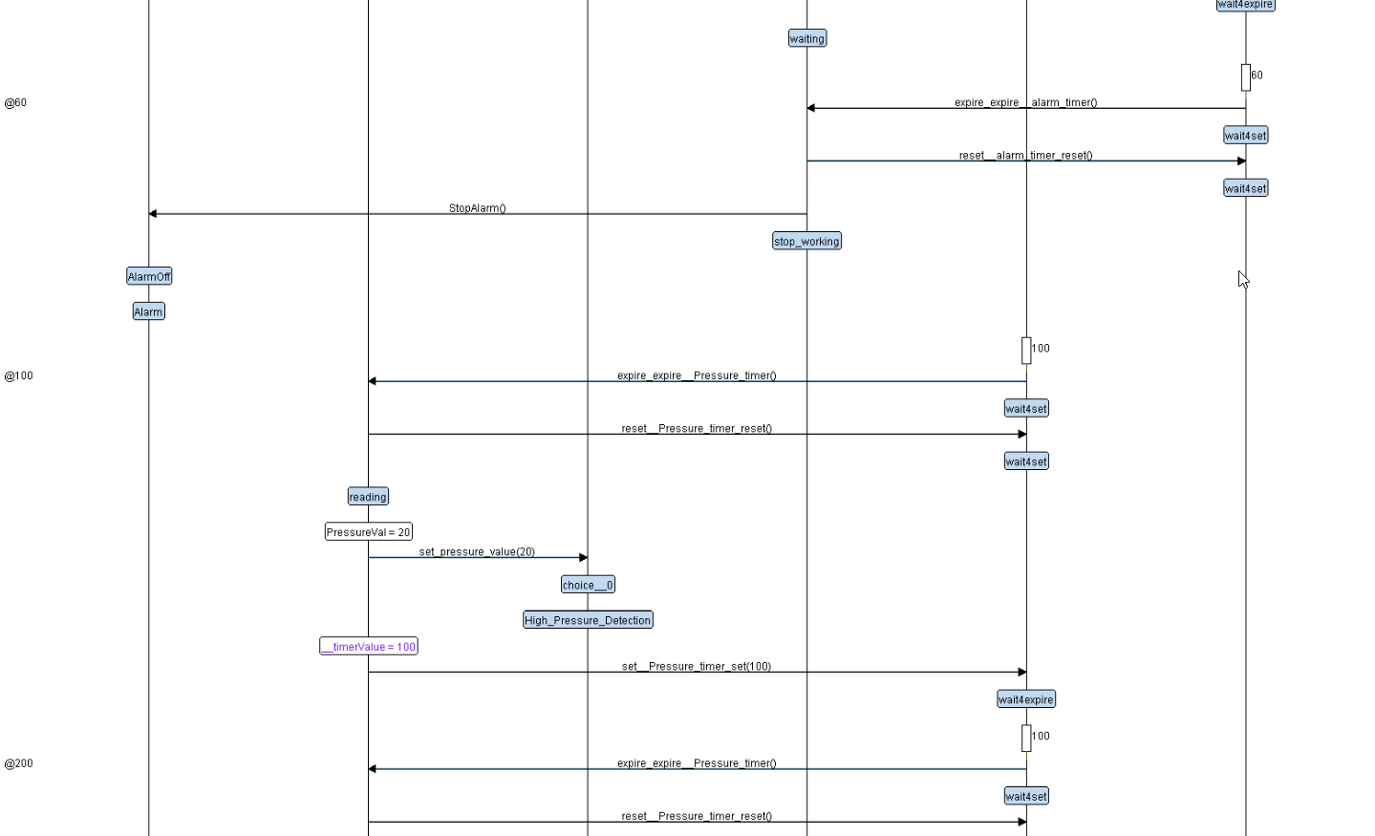

Slide 18
IMPLEMENTATION
PressueSensor.c
PressueSensor.h
Algorithm.c
Algorithm.h
AlarmMonitor.c
AlarmMonitor.h
Alarm_Led.c
Alarm_Led.h
driver.c
driver.h
States.h
linker.ld
Startup.c
makefile

Slide 19
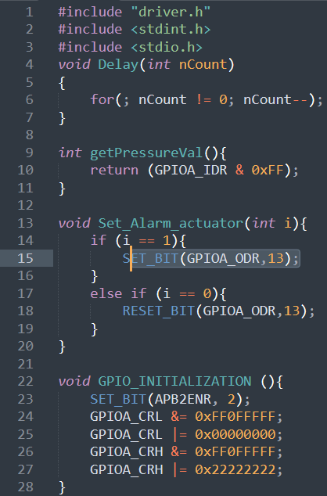
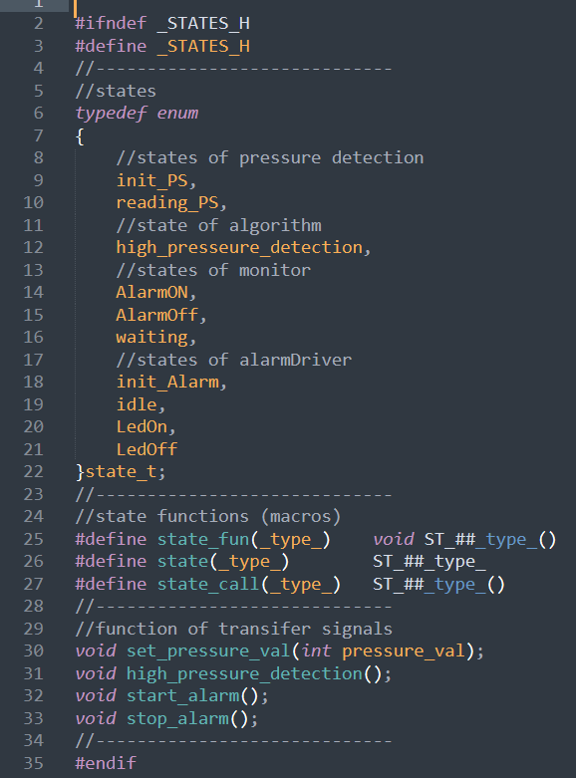
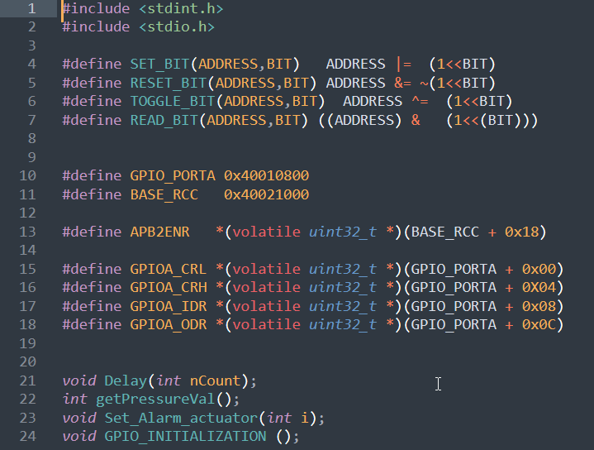
States.h driver.h driver.c

Slide 20
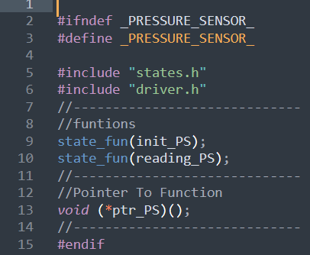
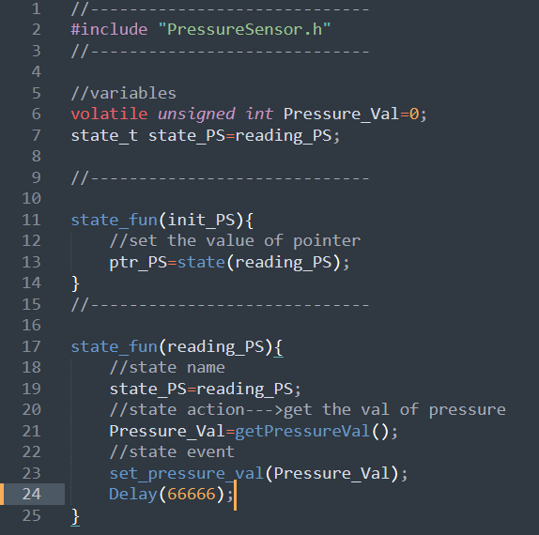
PressueSensor.h PressueSensor.c

Slide 21
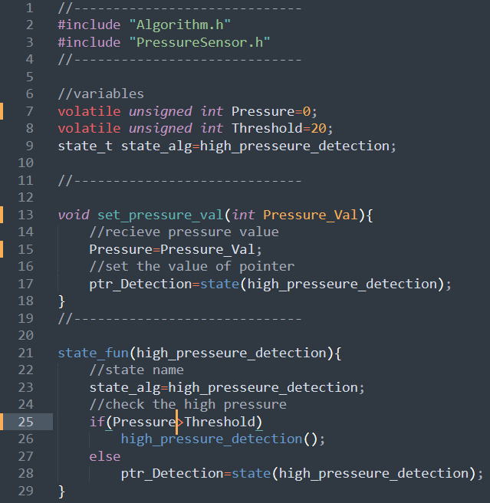
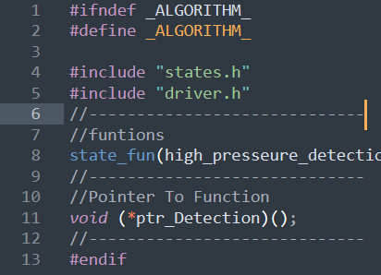
Algorithm.h Algorithm.c

Slide 22
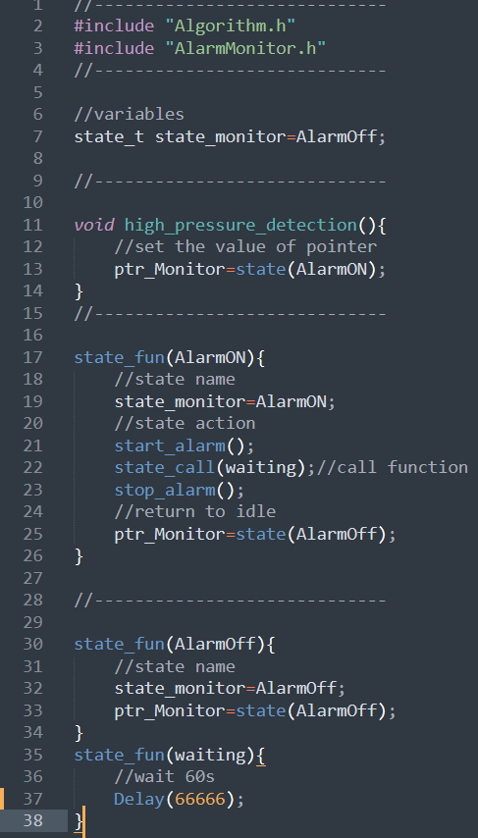
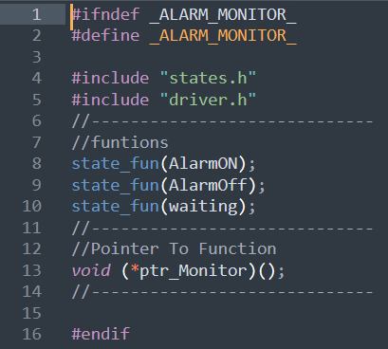
AlarmMonitor.h AlarmMonitor.c

Slide 23
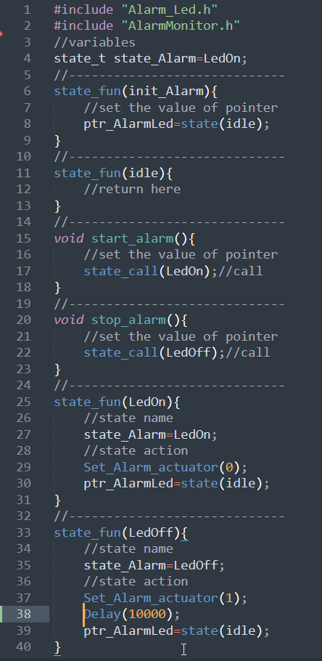
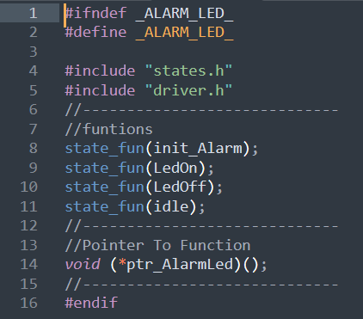
Alarm_Led.h Alarm_Led.c

Slide 24
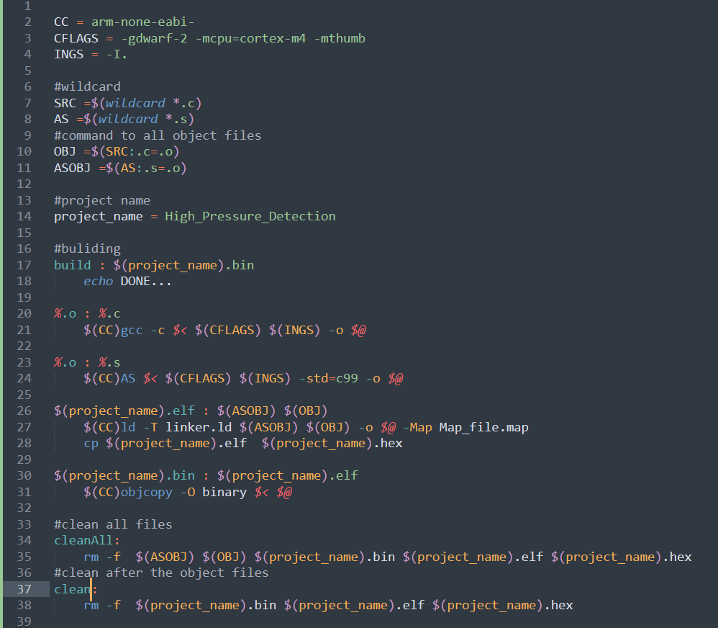
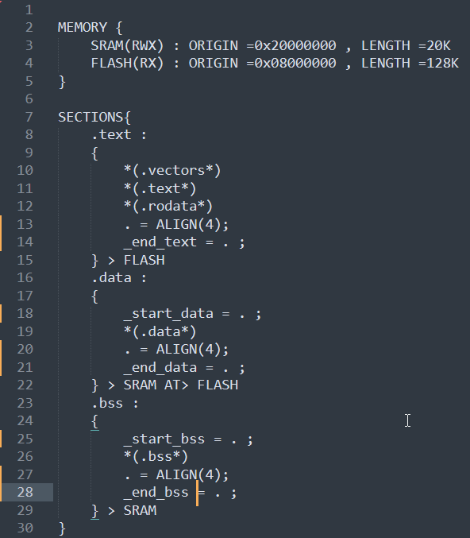
linker.ld makefile

Slide 25
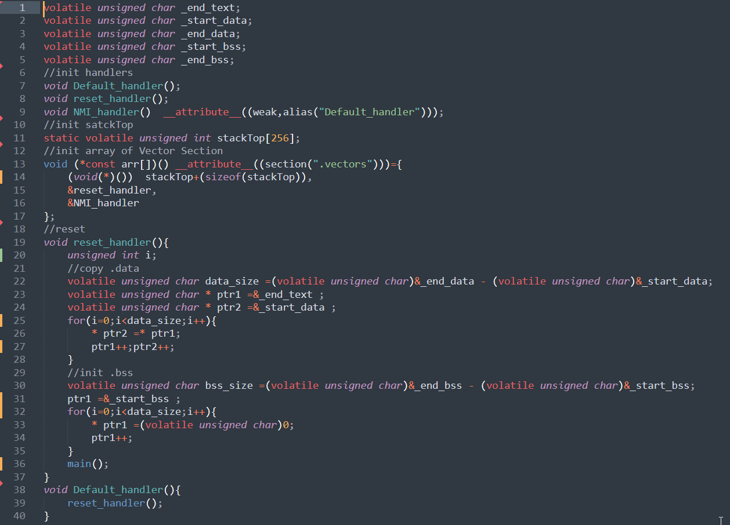
Startup.c

Slide 26
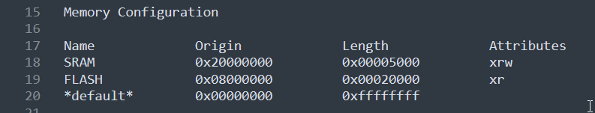
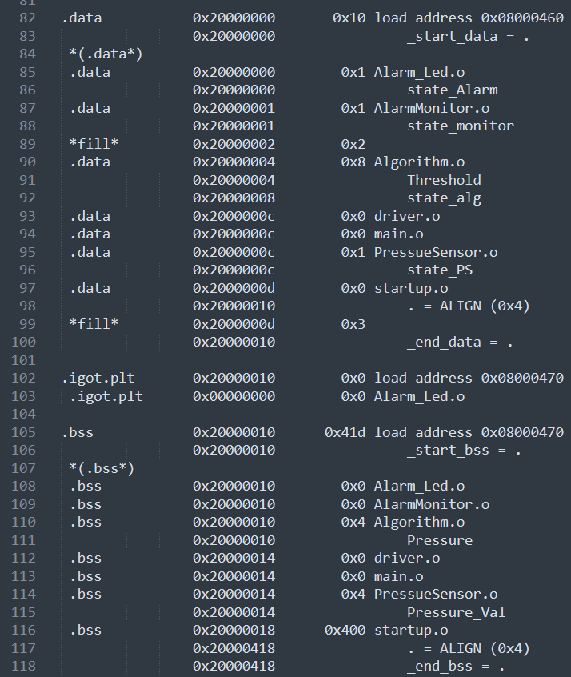
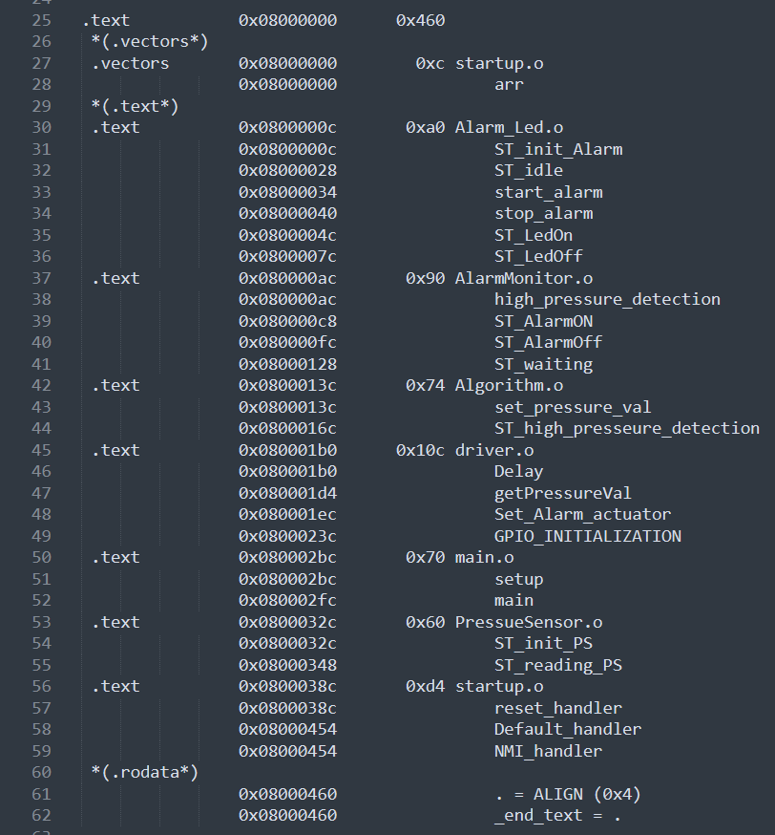
Mapfile.map

Slide 27
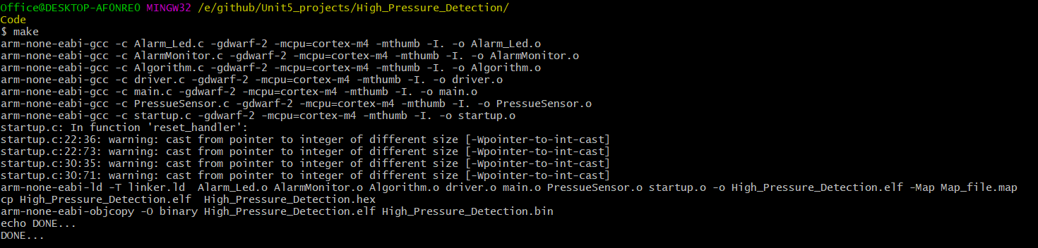
Building with makefile in terminal

Slide 28
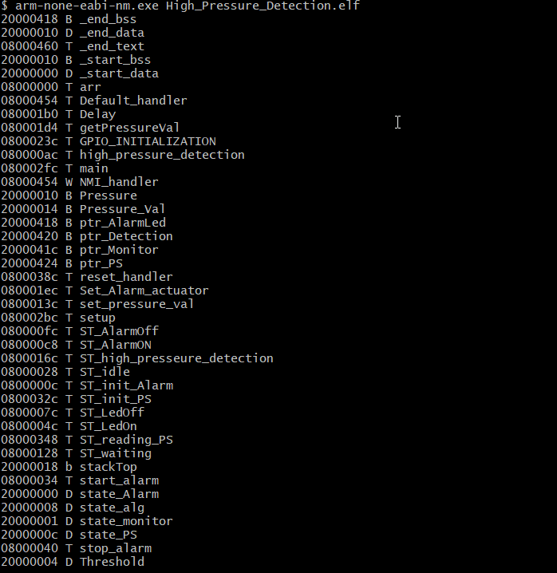
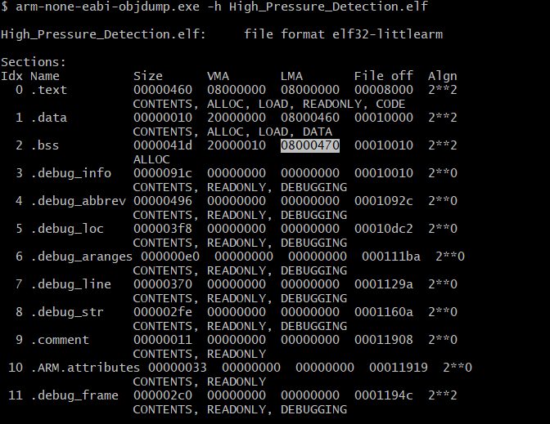
Sections of project.elf Symbols of project.elf

Slide 29
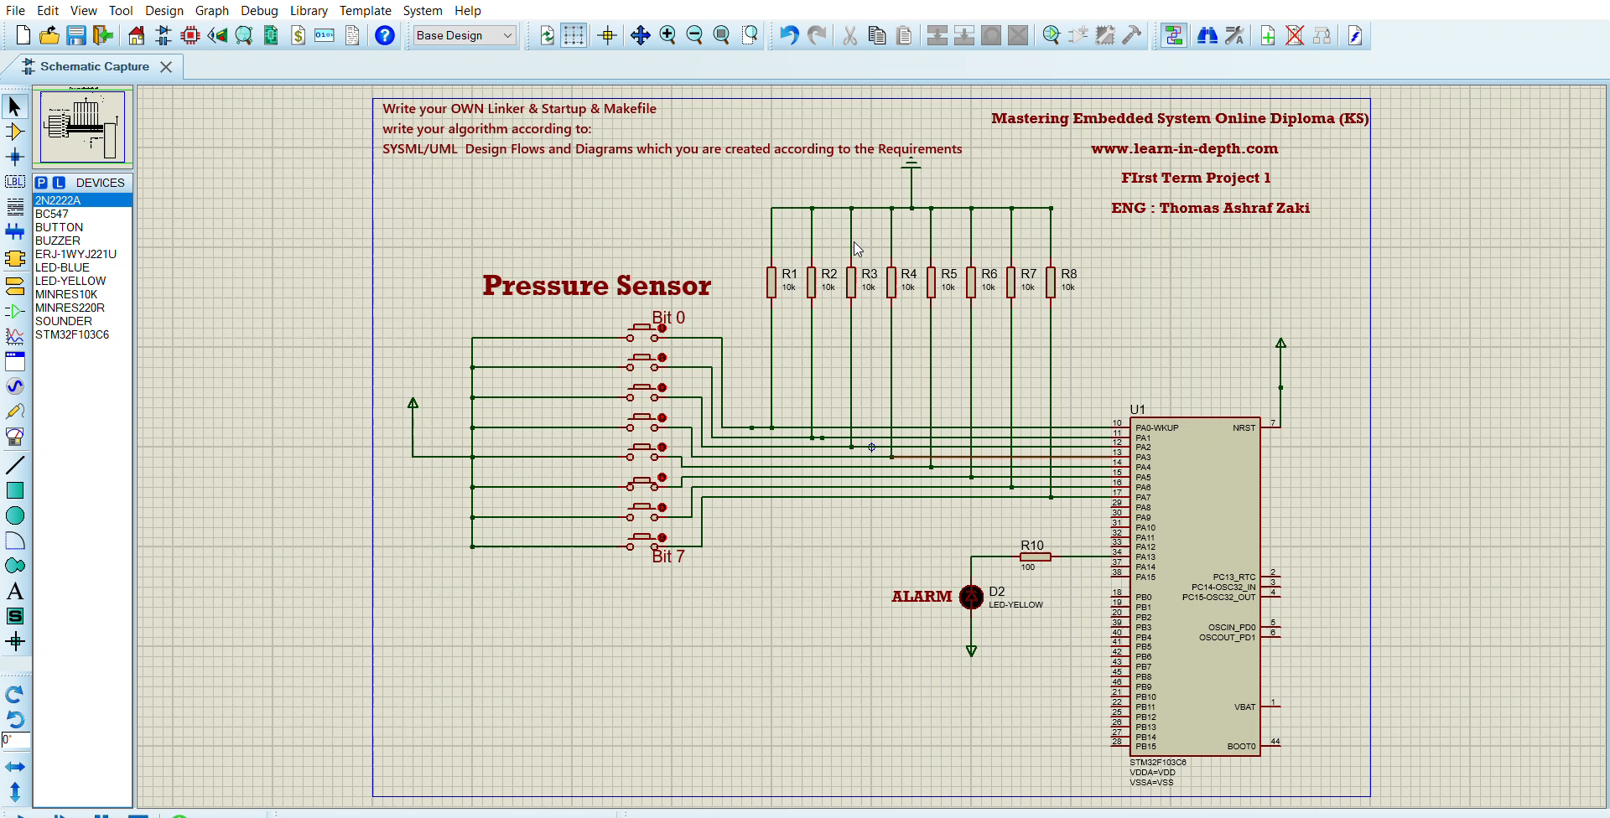
Video of Simulation Link: click here

Slide 30
THANKS
Under the supervision of
Eng: Keroloes Shenouda Khalil (here)

